Slide 1
SAP BTP Extension Suite Training
Day 7
Anubhav Oberoy
www.AnubhavTrainings.com
Follow excellence with sheer passion

Slide 2


DISCLAIMER
The training content and delivery of this presentation is confidential, and cannot be recorded, or copied and distributed to any third party, without the written consent of Anubhav Trainings

Slide 3
Agenda – Day 7
01
CDS Views
02
Create First Service
03
Create & Test OData Service

Slide 4
Introduction to CDS Views
1. Usually we have all our data distributed across multiple tables, and if we need to get this data out, we need to write complex queries with joins. It becomes very complex to handle the maintenance of these large queries. Views will simplify the consumption and make it easy to maintenance.
2. We can perform operations like aggregation on the view.
3. Security
4. CDS views are also the contracts for data consumption
5. They include annotations which drive functionality.
6. View provide lose coupling to load data. Whereas when we use queries and joins, they are always tight coupling.
Exercise:
https://github.com/soyuztechnologies/SAP_BTP_Training_CLD200/blob/master/Day%203/01%20db/01db/CDSViews.cds
Purchase order
Purchase order items
Load what is needed

Slide 5
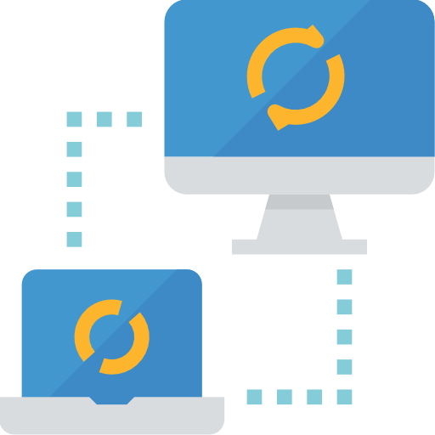
Hands on: Service creation
Solution
https://github.com/soyuztechnologies/SAP_BTP_Training_CLD200/blob/master/Day%203/02%20srv.zip

Slide 6
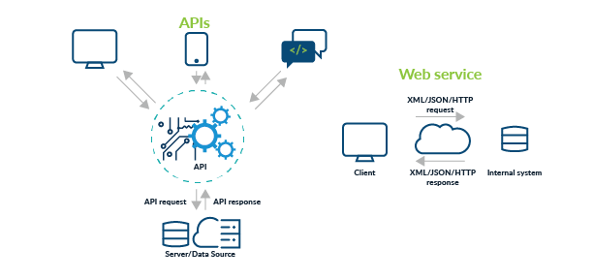
Testing Services in BAS
Exercise:
https://github.com/soyuztechnologies/SAP_BTP_Training_CLD200/blob/master/Day%203/02srv/tester.http

Slide 7
Actions and Functions
In addition to common CRUD operations, you can declare domain-specific custom operations as shown below. These custom operations always need custom implementations in corresponding events handlers.
Actions vs Functions
The differentiation between Actions and Functions stems from the OData specifications and in essence is as follows:
Actions are meant for operations, which add or modify data in the server; they are called through POST request with the arguments passed in application/json bodies.
Functions are meant for operations, which only retrieve data from the server; they are called through GET requests with the arguments passed in the URL path.
Exercise:
https://github.com/soyuztechnologies/SAP_BTP_Training_CLD200/blob/master/Day%203/02srv/CatalogService.cds
https://github.com/soyuztechnologies/SAP_BTP_Training_CLD200/blob/master/Day%203/02srv/CatalogService.js

Slide 8
Generic Handlers in CAP
The CAPM framework generates most of the code to perform CURDQ operations on the entity. It does not know what validations to perform on our business data. As a developer, when we want to attach a pre-check (validations) / post-check (post processing code) on an entity operation, we can use generic handlers. All these operations are performed SYNCHRONOUSLY.
At times we want to
Take full control of our implementation
We want to add some validation before data is inserted or updated
We want to change data before insert/update
Read some extra information while GET calls
Fiori app
odata
cap
Generic handlers
database
before
on
after

Slide 9

Hands on: Generic Handlers

Slide 10
Syntax
this.when(‘WHICH’, what, () => {
code.
})
when – before, after, on
Which – CREATE, UPDATE, DELETE, READ
What – Entity (Employee, Pos, …)

Slide 14

What We Did
Let’s Summarize

Slide 15

www.anubhavtrainings.com
Thank You
End of Day 4

Slide 16


We’re committed to empower you to be
#FutureReady
through powerful training solutions.
We build the workforce of the future.
250+
Corporate Clients
50,000+
Learners Trained
25000+
Learners Placed
FREE WEBINARS
Sign up for free webinars with industry experts every fortnight!
Enroll Now!
Contact us today!
https://anubhavtrainings.com

Slide 17
Agenda – Day 4
01
04
Introduction to HANA Cloud
Identity Provider
02
05
Connecting to HANA Cloud Instance
JWT Token and Application Router
03
06
Authentication v/s Authorization
Deploy App to CF

